Slide 1

Machine Learning Project
Theme no.7:
Heart Failure Prediction
jdszr6, World Data Analysis
29.05.2022

Slide 2
Our team
Błażej Ratman
Data Scientist
Jonasz Krawczyk
Application Designer
Angelika Popiela
Data Scientist
Hubert Stadnicki
Business Analyst

Slide 3

Goals list
Data exploration
Creation of the most efficient classification model which enables us to detect the largest possible number of patients most at risk of heart failure
Creation of a model-based, user-friendly, and giving instant predictions application supporting employees in the medical industry
Development of deployment proposals and calculation of potential benefits for patients and profits for medical facilities resulting from the application implementation

Slide 4
Data exploration ►►

Slide 5
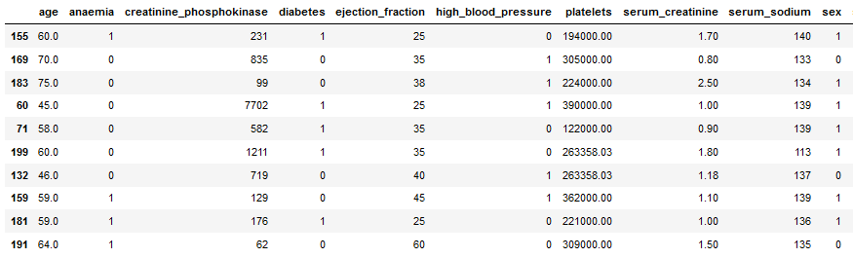
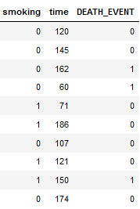
Dataset
https://www.kaggle.com/datasets/andrewmvd/heart-failure-clinical-data/metadata
A relatively small medical dataset contains almost 300 observations describing the health of the patients.

Slide 6
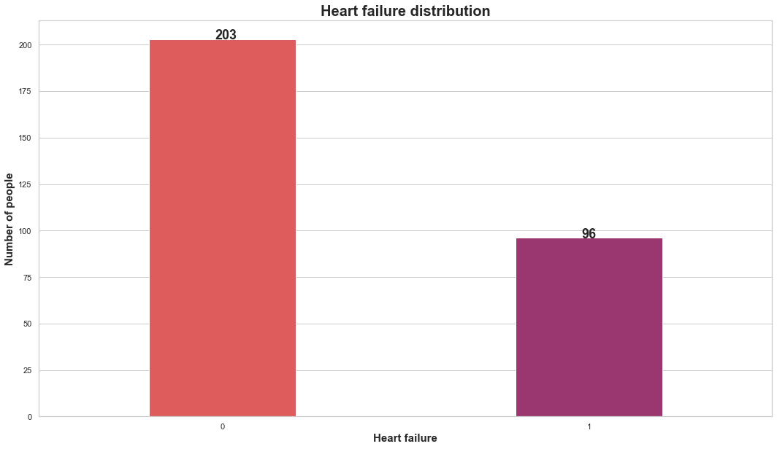

Slide 7
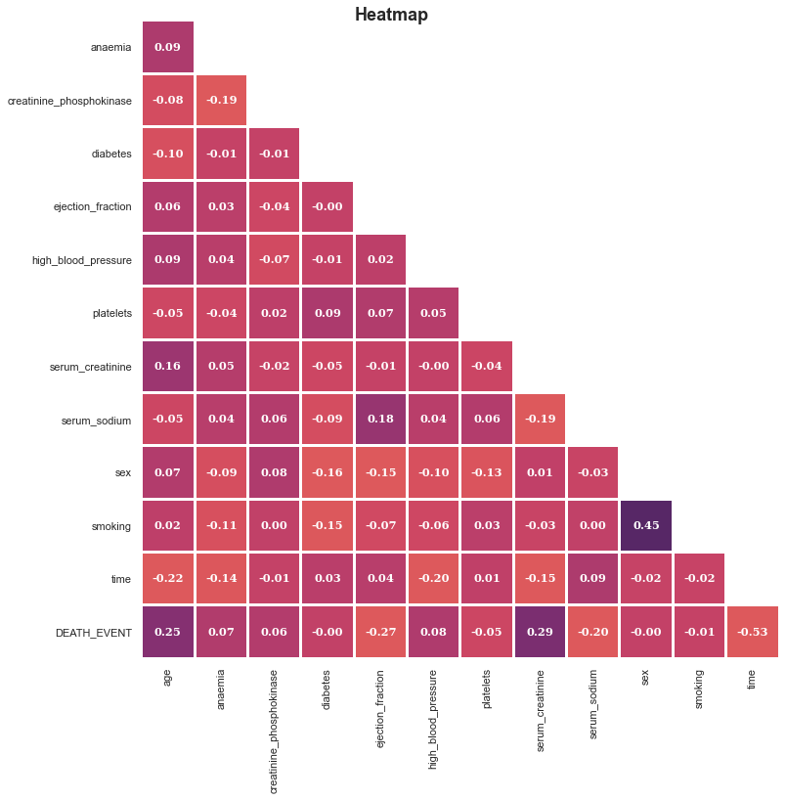

Slide 8
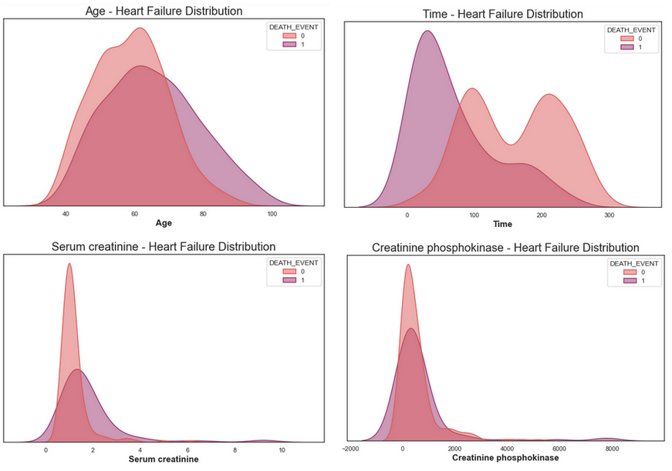

Slide 9
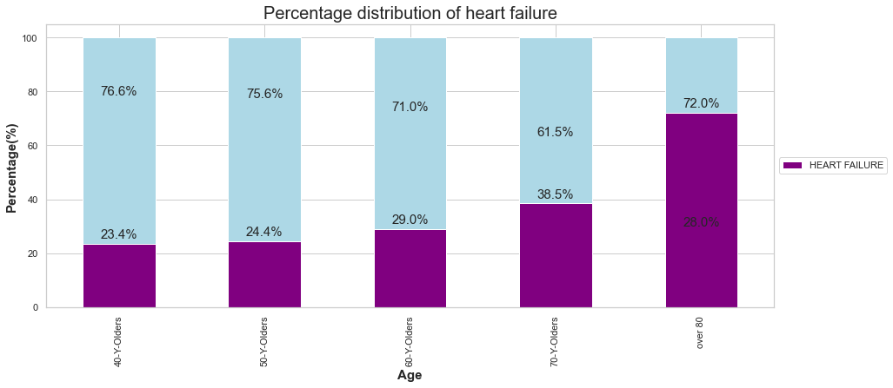
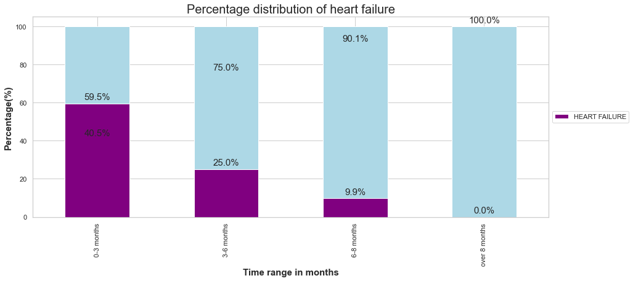

Slide 10
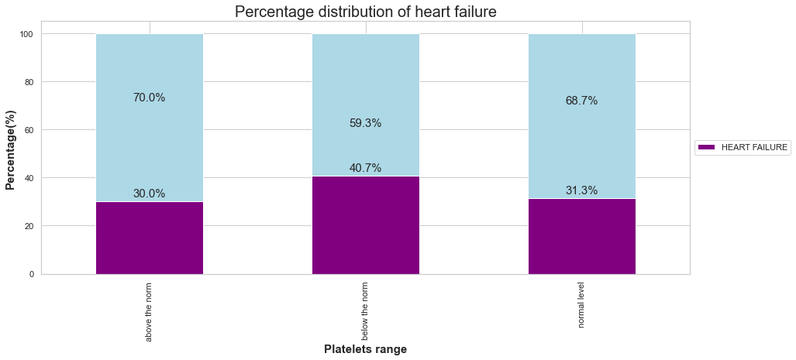
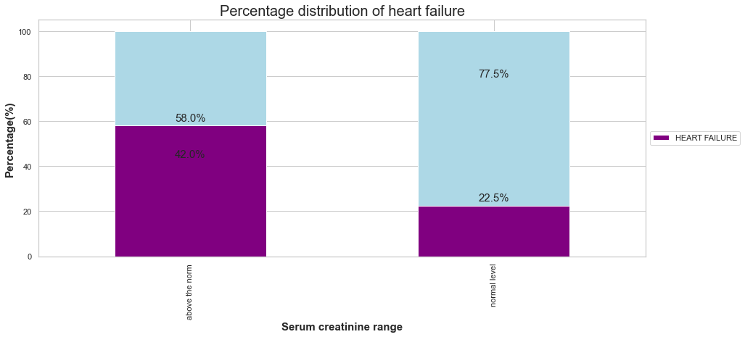

Slide 11
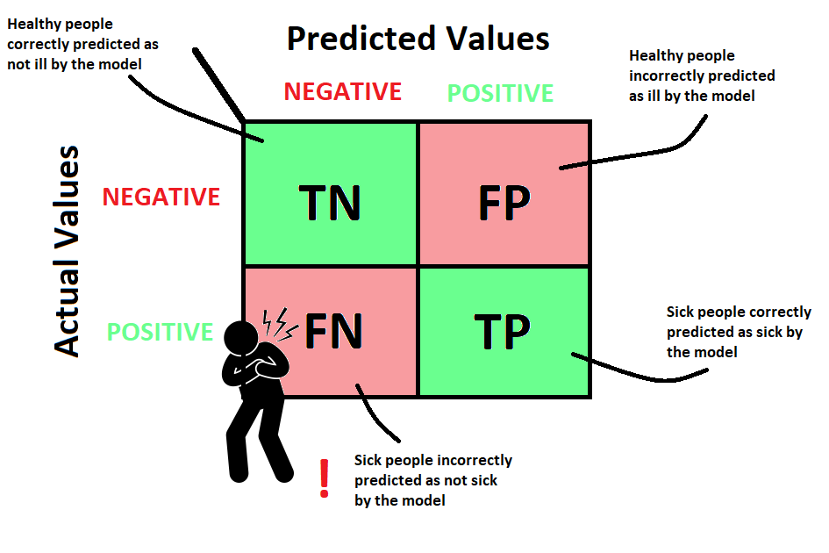
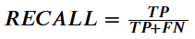
The main evaluation metric of our model

Slide 12
Models comparison ►►

Slide 13
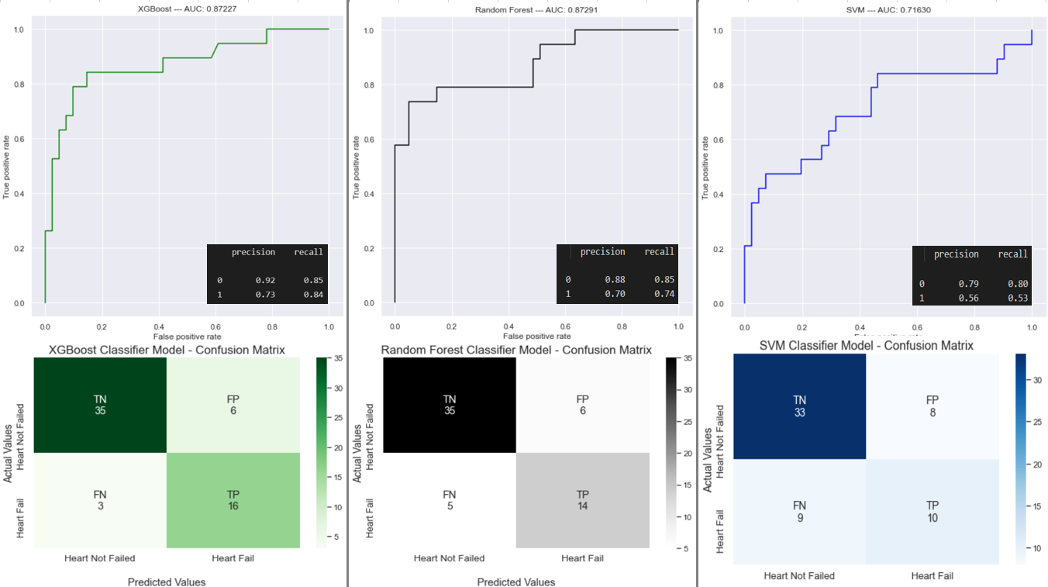
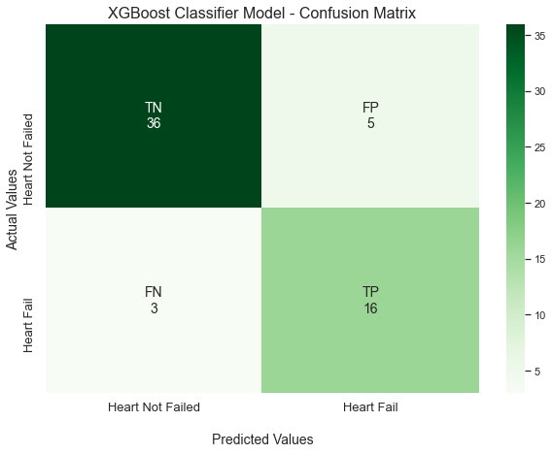

Slide 14
Application ►►

Slide 15
Business analysis ►►

Slide 16



Market summary
New technologies find more and more applications in medicine. To be effective and efficient, the health service must invest in innovative solutions.
Health care facilities, both state and private, spend more and more money on investments in the automation of the services provided (e.g. e-sick_leave, e-prescription, e-visit)
There is no solution on the market that offers what our application can do. This is our advantage.

Slide 17
Health care problems (Doctors report E-Health 2018)
Shortage and aging of staff
Time for the patient
The lowest number of practicing doctors amoung EU countries (average 3.8, Poland 2.4 on 1000 residents). The average age of a specialist doctor is 54 years.
During a 20-minute visit, on average the doctor spends about 5 minutes with patient.
Excessive bureaucracy
New technologies
During a 20-minute visit, the doctor spends an average of 15 minutes checking the medical history, analyzing the test results or entering information about the patient into the system.
Slow pace of implementation of new technologies in health care sector.

Slide 18
Business concept
By using our application, we help doctors in analyzing patient results. However, thanks to the data provided by customers working with our application, we are able to develop our product and increase its accuracy of prediction.

Slide 19

Profits after implemention of app
We can assume that the physician’s analysis of the patient’s test results and qualifying him to the appropriate risk group for death takes an average of 5 minutes during a 20-minute visit.
Using our application, we shorten this time to 1 minute while maintaining high accuracy of prediction and the same efficiency of work from the first to the last patient.
So in fact we save 4 minutes which is 20% of total visit time.

Slide 20
Profits in numbers
Annual income
 | Patients number (total by year) | Total time of visits (h) | Total time saved (h) | Income*
Before | 1000 | 333 | 0 | 150,000
After | 1000 | 266 | 66 | 187,050
We assume that cost of one visit is 150 PLN
Saved 66 hours is converted into a visits and added to the income
Annual income increased by 25%

Slide 21

Summary
The implementation of the application will allow doctors to automate their work while maintaining high accuracy of predictions.
The time saved will help increase the income of medical facilities, shorten the waiting time for the visit or extend the visit time for patients with a high probability of death, thanks to which it will be possible to save another human life.

Slide 22
Thank you GitHub:
jdszr6-World-data-analysis/Projekt_ML at master · infoshareacademy/jdszr6-World-data-analysis (github.com)

